Slide 1
Circuits in Series

Slide 2
By the end of this lesson you will be able to:
Explain what a series circuit is.
Describe what happens to current and voltage in a series circuit.

Slide 3
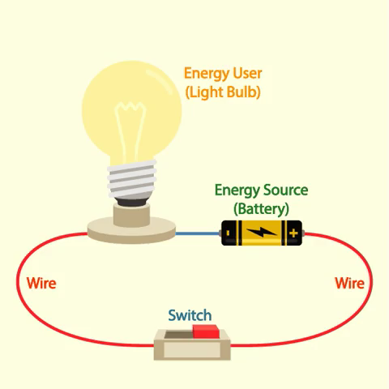
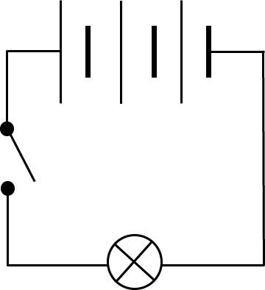
A series circuit is formed when all the circuit components are in a line.
The circuit forms a single loop. A series circuit is pictured below:

Slide 4
All the circuit components are on the same loop of wire in series circuits.
This means that the same current flows through every circuit component. Wherever you measure the current in a series circuit it will always remain the same value.
Remember, the current describes the rate of the flow of charge around the circuit. It measures how much charge passes a point in the circuit over one second.

Slide 5
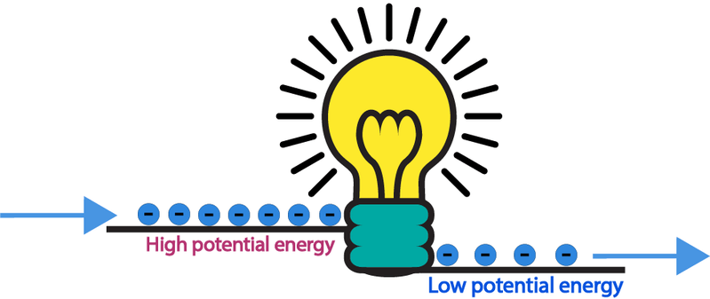
Voltage is not necessarily the same over every circuit component.
If two circuit components have different resistances, there will be a larger voltage over the component with a larger resistance.
Remember, voltage is a measure of the difference in potential energy between two points. If a component has a high resistance, more energy is lost as the current travels through, creating a greater voltage drop.

Slide 6
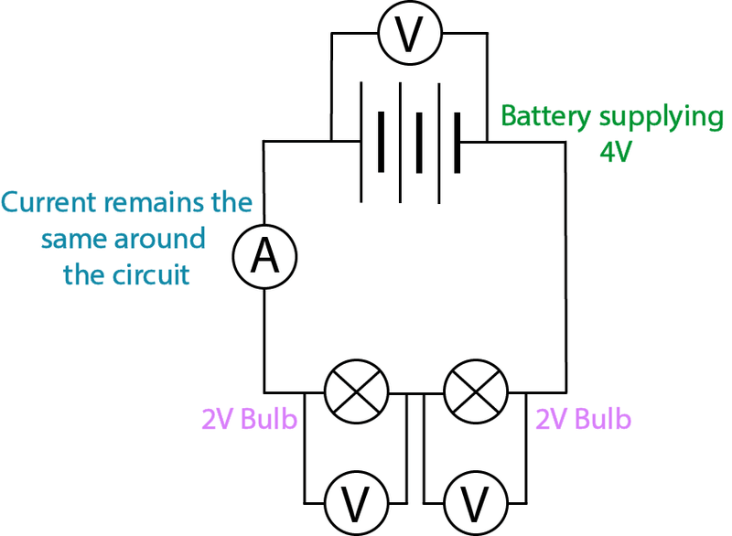
If all the circuit components have the same resistance, each one will have the same voltage across them.
You can add up the voltages across each circuit component to find out how much voltage a battery is supplying.
For example, in the circuit below, the battery may supply 4 V of energy. If each light bulb has the same resistance, there will be 2 V of voltage across each bulb.

Slide 7
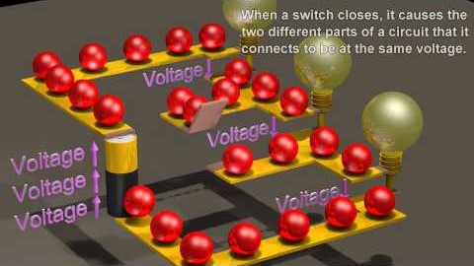
The key thing to remember about series circuits is that all the components are connected in one loop.
Watch this video (1:13) to summarise the information you just learnt about current and voltage in series circuits.

